Slide 1

Patient Management System
Team Blue
Lars Gertsch | Simon Herrmann | Steve Blaser | Fabio Caggiano | Silas Stulz | Sinthujah Kaneshan

Slide 2
Contents
- Features implemented vs. Design thinking ideas
- Architecture & coding highlights
-
- Lessons learnt / Scrum retrospective

Slide 3

Features implemented vs. Design thinking ideas

Slide 4
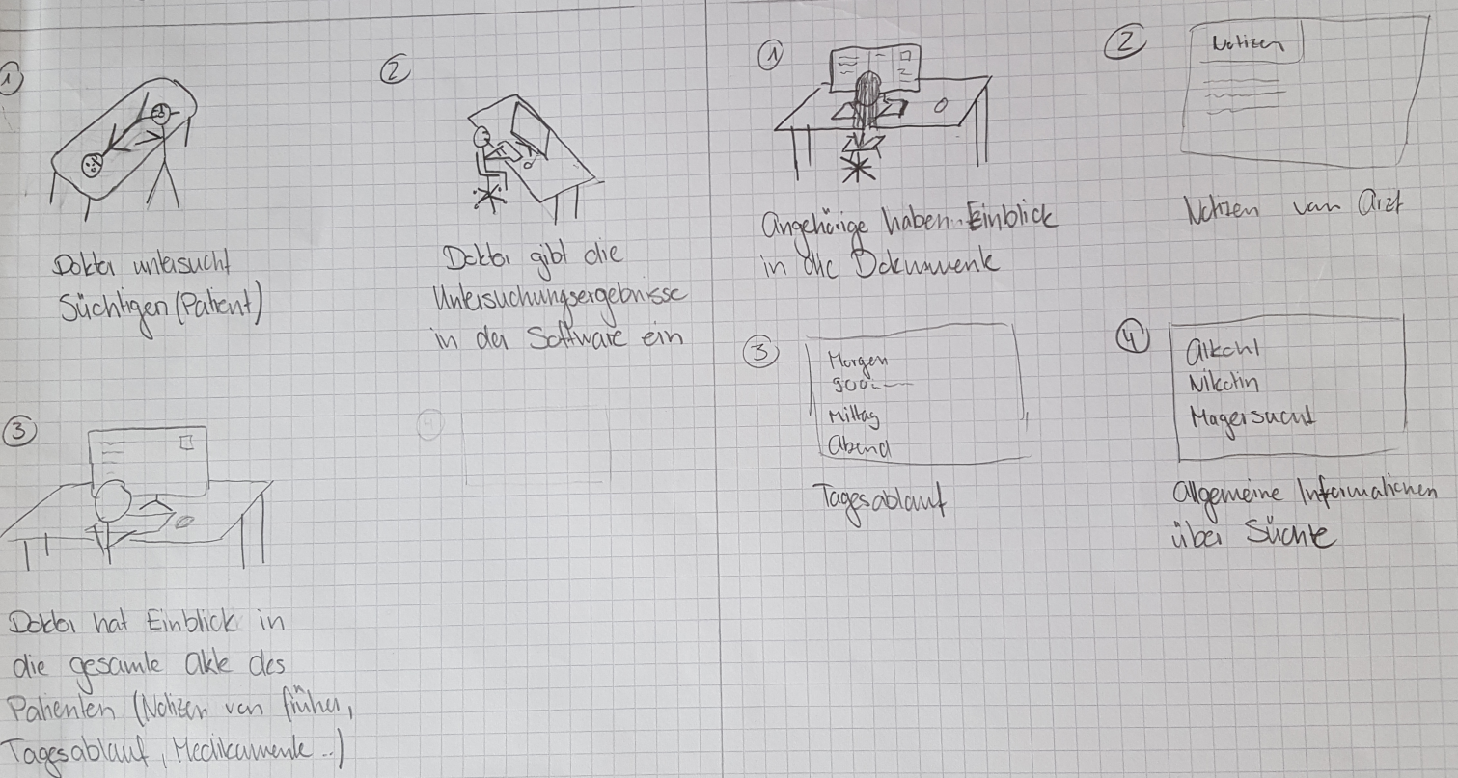

Slide 6
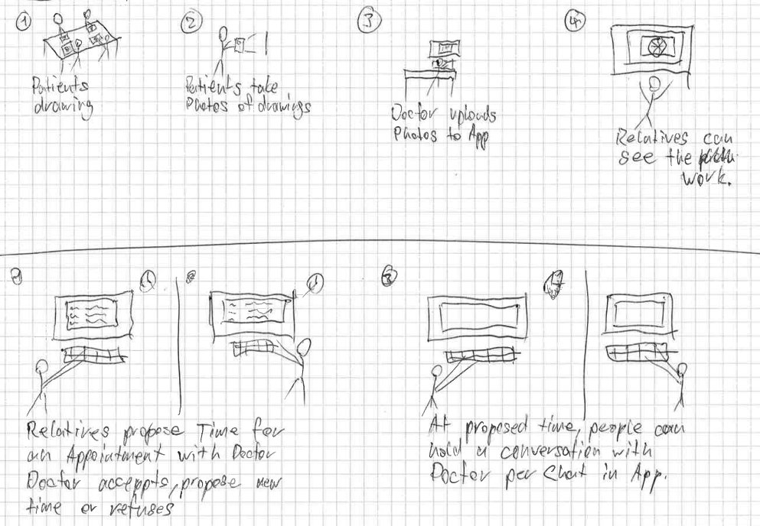
Team Blue
6

Slide 8
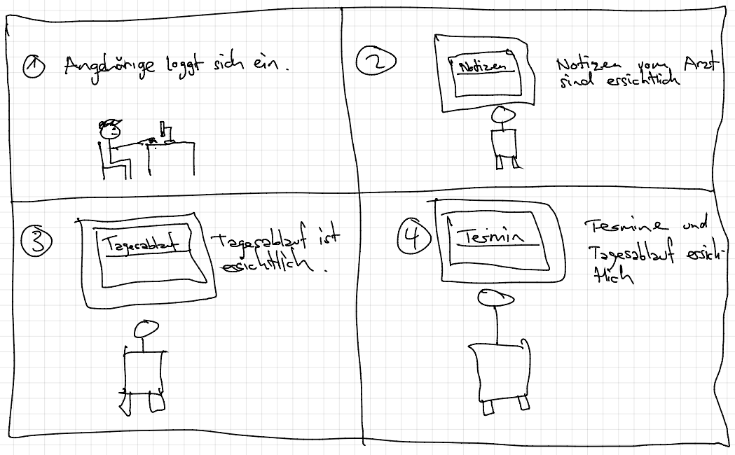

Slide 10
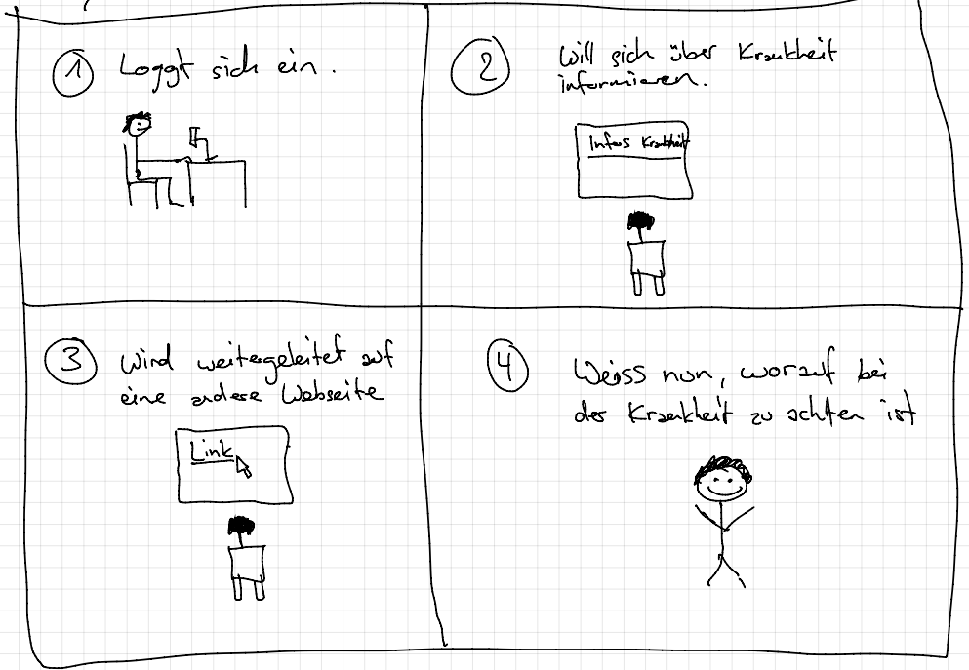

Slide 12
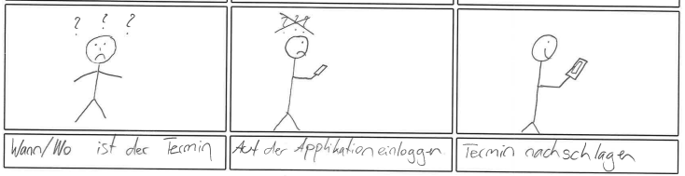

Slide 14
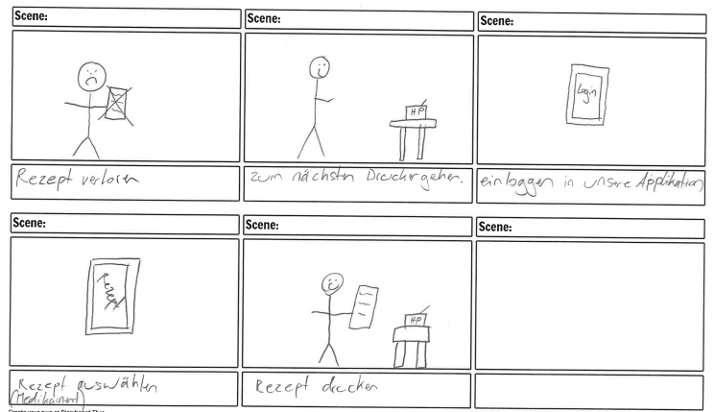

Slide 16
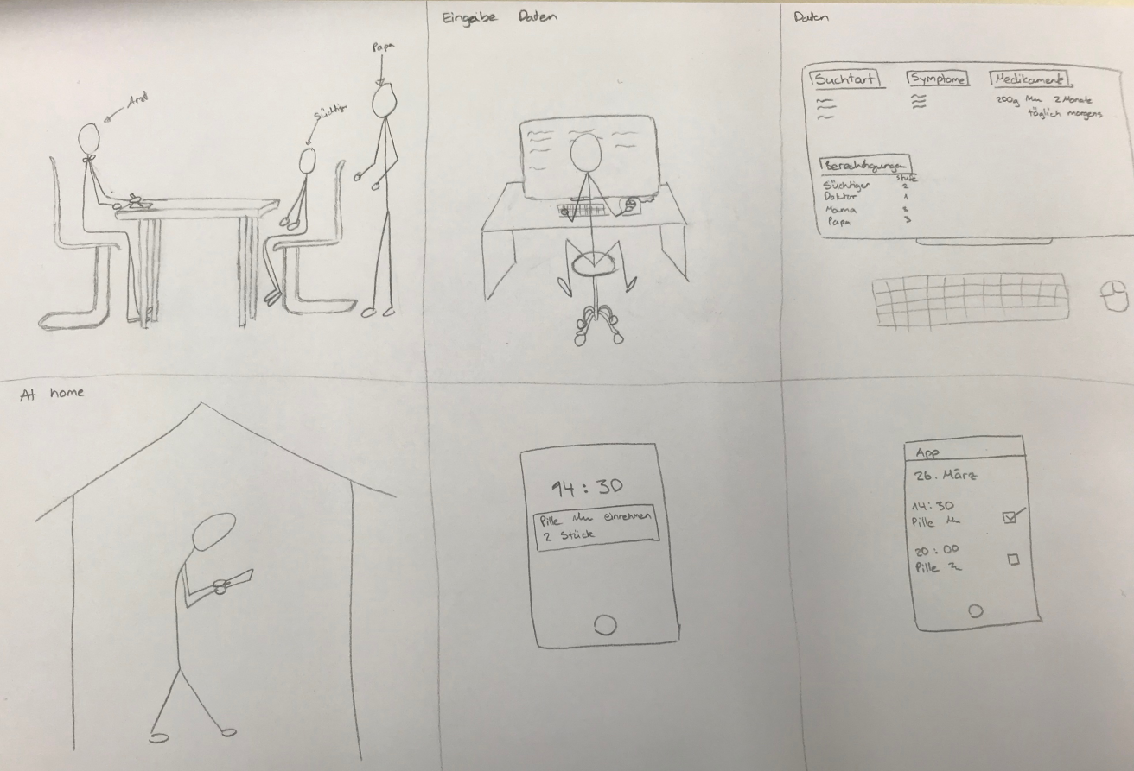

Slide 18
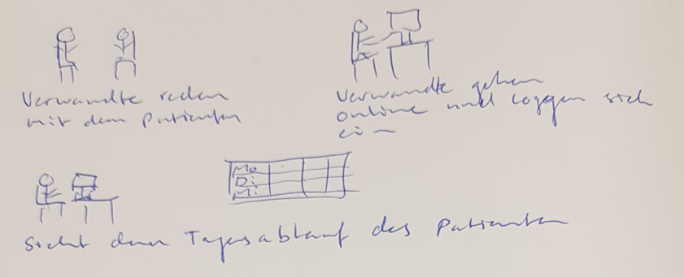
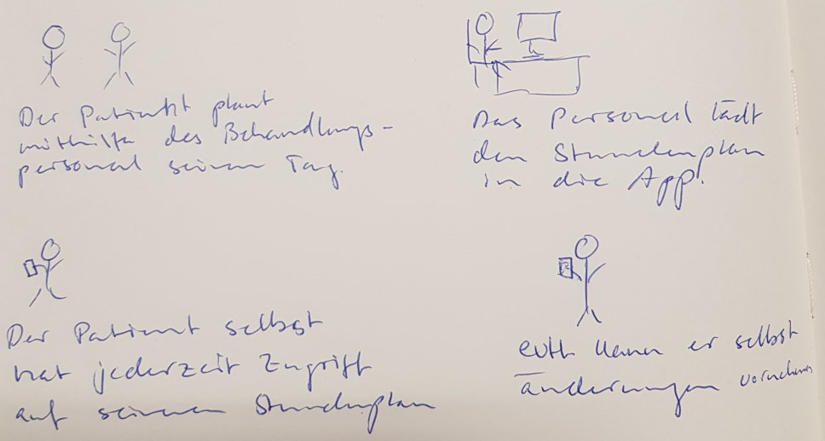

Slide 20
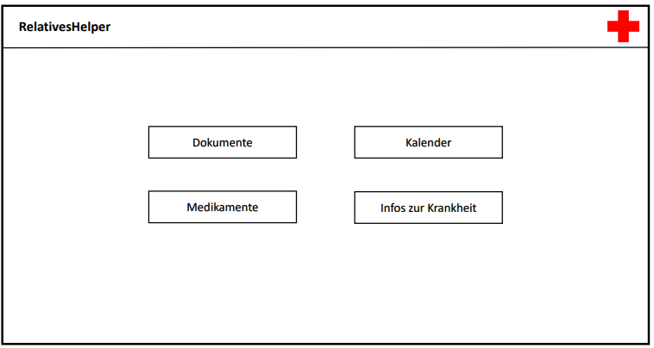
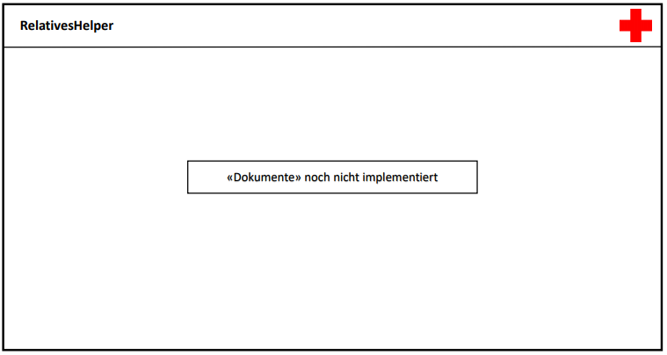

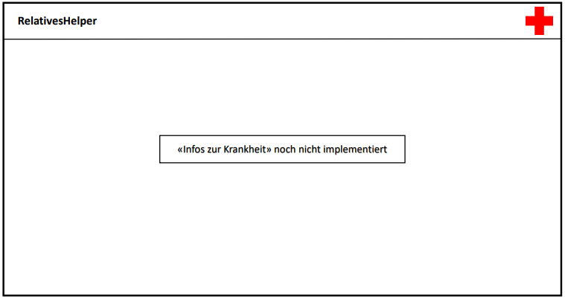
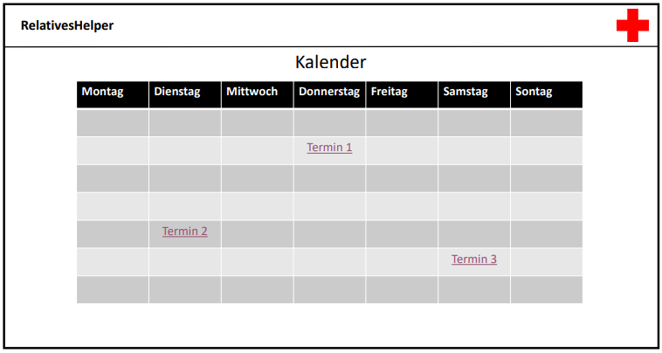
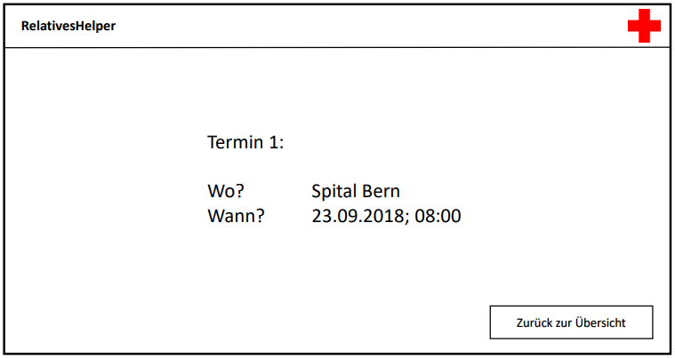

Slide 22
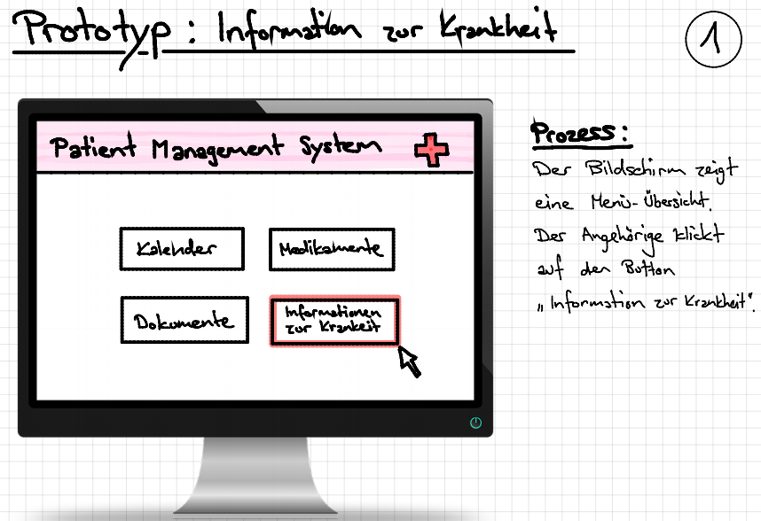
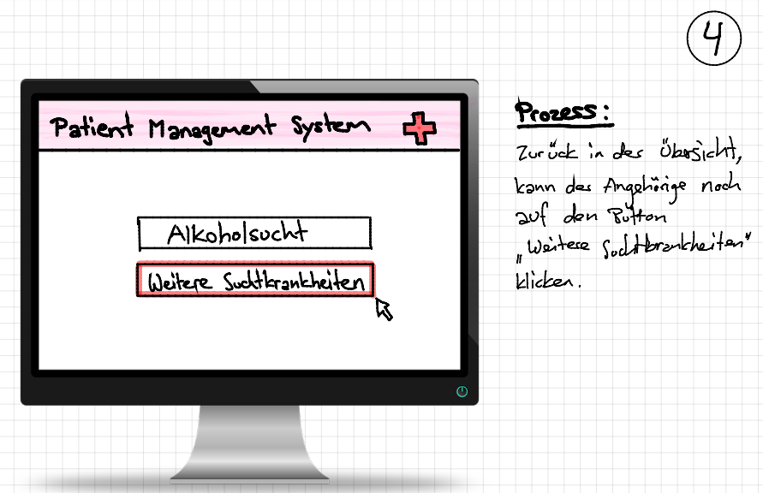
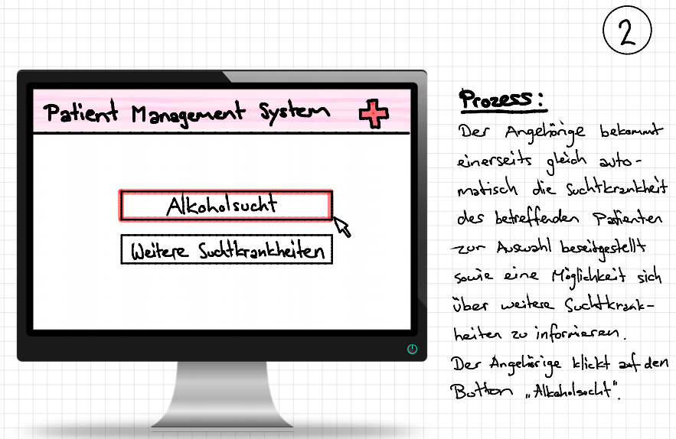
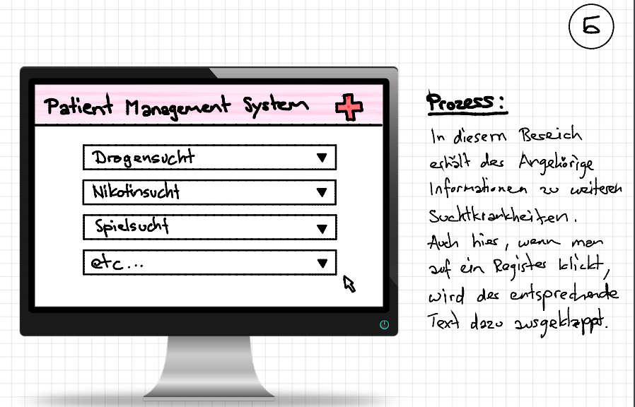
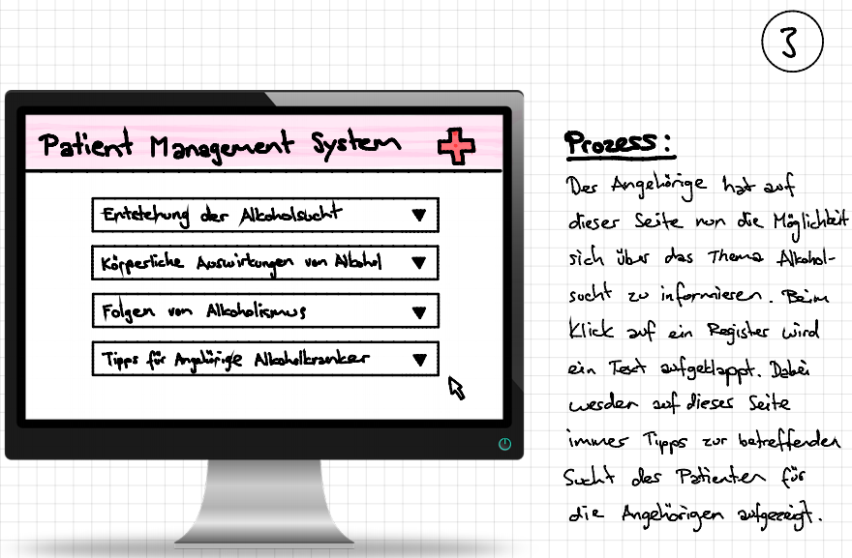

Slide 24
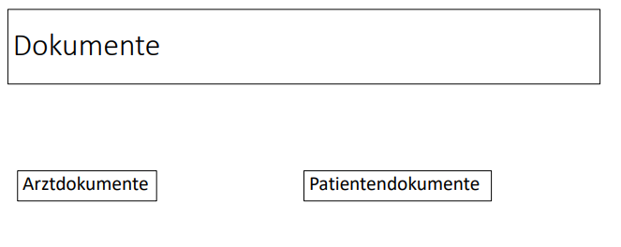
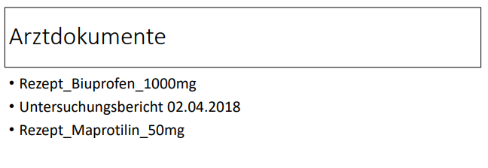
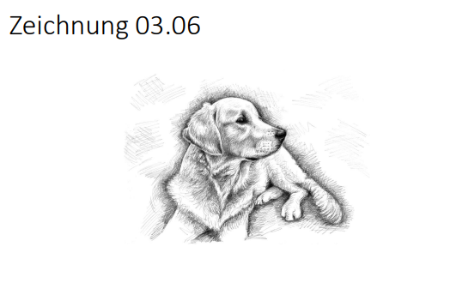
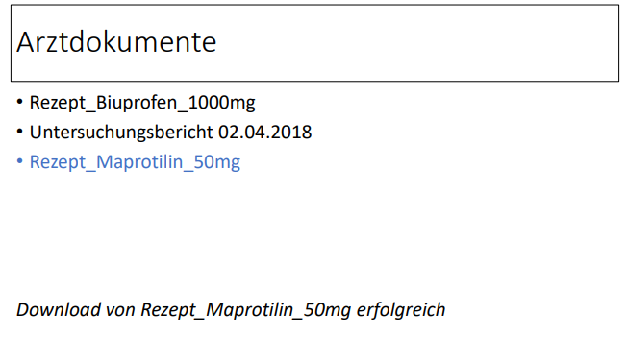

Slide 26

Architecture & coding highlights

Slide 28

Personal Contribution

Slide 29
Startsite

Slide 30
Kalendar

Slide 31
Information

Slide 32
Chat

Slide 33
Information

Slide 34

Lessons learnt / Scrum Retrospective

Slide 35
Lessons learnt

Slide 36
Retrospective

Slide 37


